Slide 1

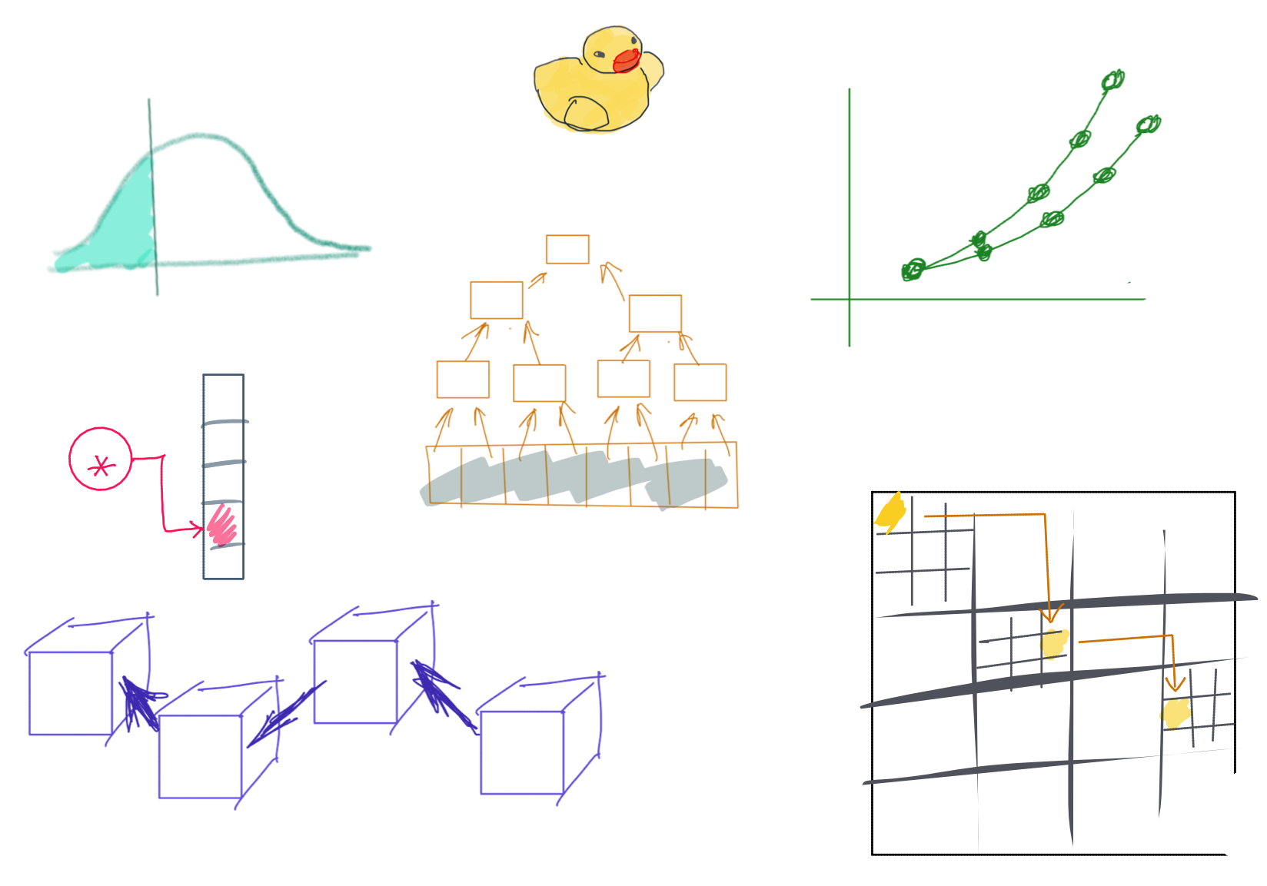

Slide 2
CSS342 Data Structures, Algorithms, and Discrete Mathematics (I)

Slide 3
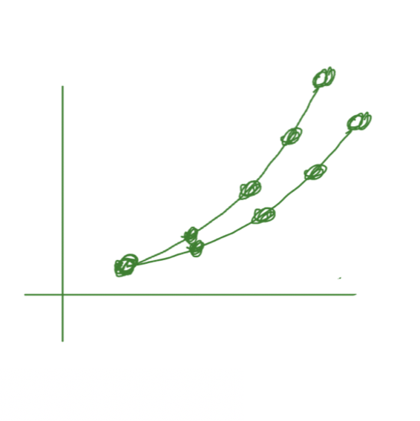
^{3rd} Week Task Items
Homework 1 due Monday midnight (11:59pm)
Pull request url in canvas
Problem 4 answers in Discord to instructor
Quiz-1
Tuesday noon to Wednesday noon, 24-hour limit
Online, Open book, you answer in a doc (pdf, txt, doc) in Canvas
Topic: C++ pointer & reference, see the Discord channel (quiz-1) for details
C++ OOP (Wed)
C++ Class, Inheritance (C++ textbook page 40-46)
Based class, derived class, (pure) virtual function
Virtual constructor, destructor
Debugging on Linux (on AWS, possibly also using WSL on Windows)
Homework 2 review (Fri)
Abstract Data Type

Slide 4
Schedule Ramping up
Week 1
(this week)
Week 2
Week 3
Week 4
C++
Dev env (IDE, Vim, debugging)
Source control (Git & Github)

Slide 5
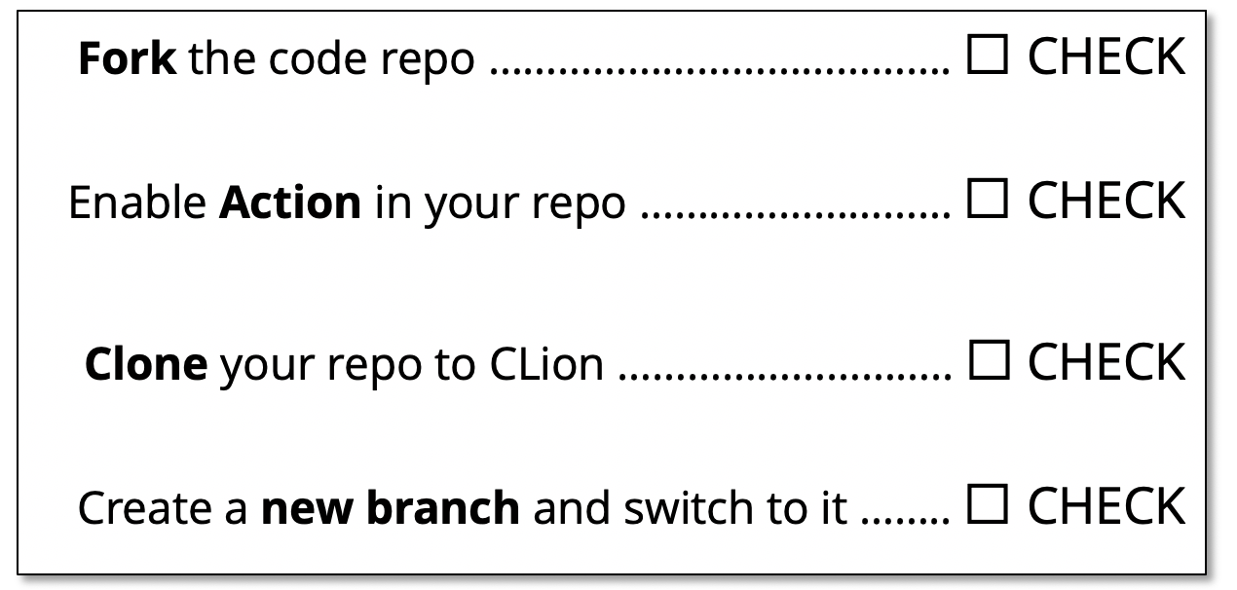
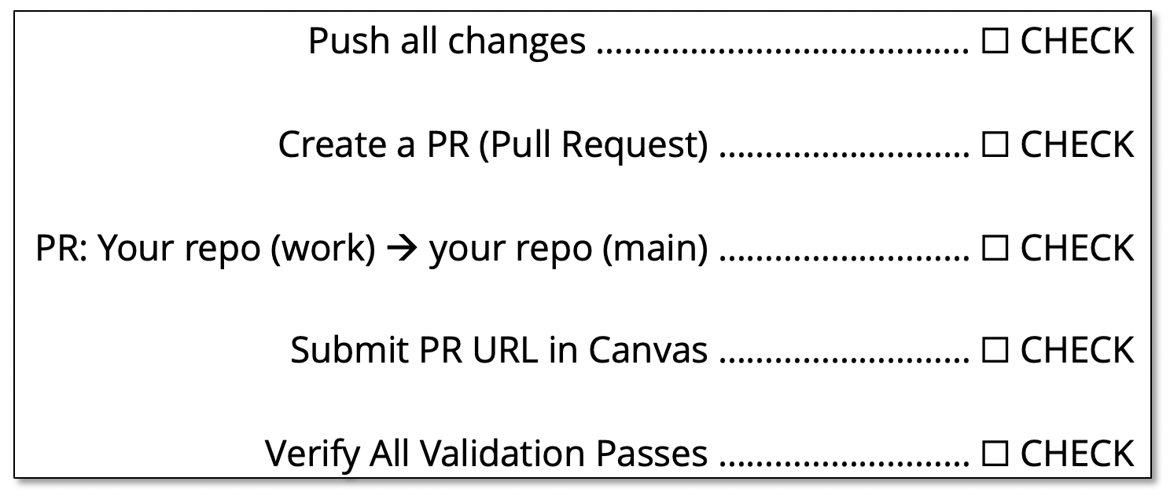

Submission Checklist
https://github.com/a-teaching-goose/CSS342A-2022-Spring/blob/main/homeworks/submission_checklist.md
1
Before Coding Checklist
3
Submission Checklist
2
Coding Checklist

Slide 6
Object Orient Programming

Slide 7
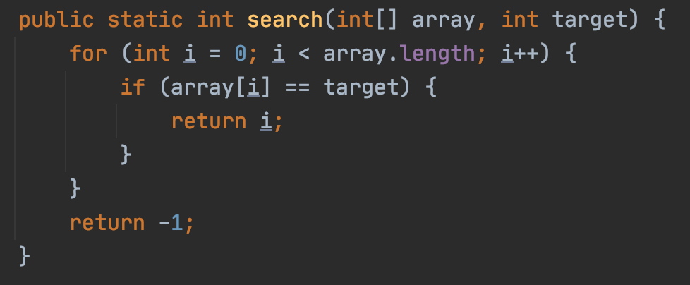
Object Orient Programming
Functional
OOP

Slide 8
Class vs Object
Class：
A Blueprint, category, type
Object：
Concrete Object
“Cat”
”Hi my name is Chloe"

Slide 9
Class Exercise
Implement a class for cats
Member Variables:
Name
Gender
Age
Member Methods:
Speak
Purr

Slide 10
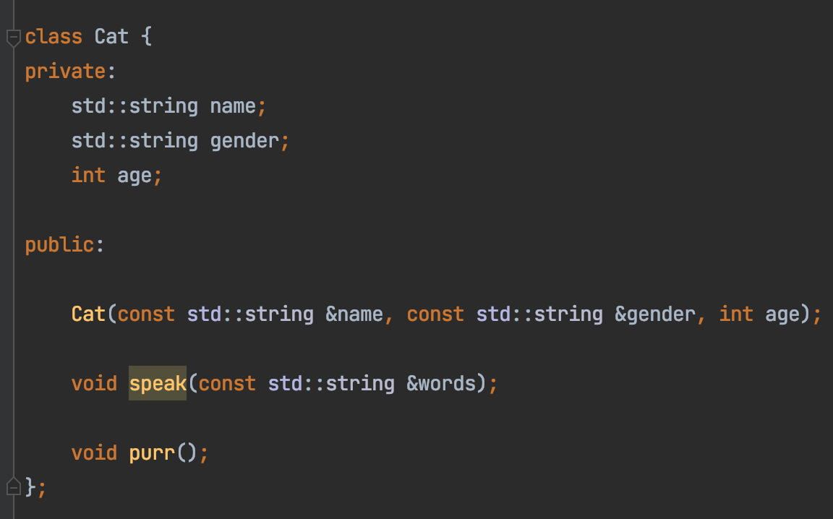
Class Exercise
Implement a class for cats

Slide 11
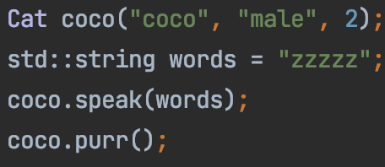
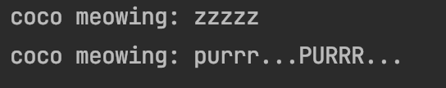
Class Exercise
Implement a class for cats

Slide 12
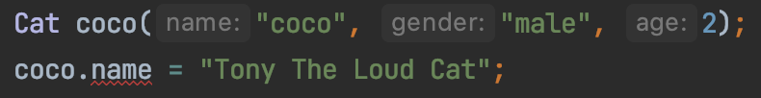

Encapsulation
Nop!
You have a new name now!
Me
☹

Slide 13
Encapsulation
Class
Variables
Variables
Setter/Getter
public Methods
Access
private Methods
Read/Write
Methods

Slide 14
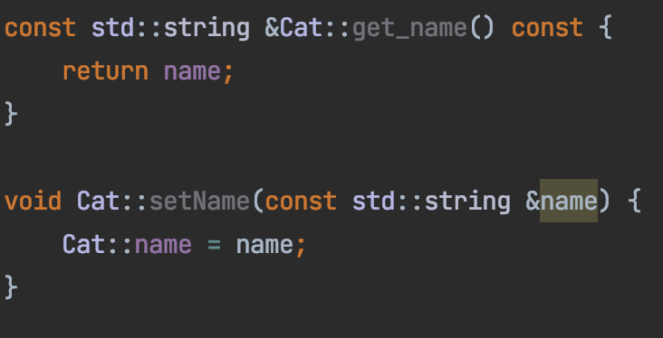
Setter and Getter
Public functions to read/write private member variables

Slide 15
Constructor

Slide 16

Encapsulation Summary
Group properties (variables) and methods (that work on properties) into a single concept call “class”
Member variables should be private
Constructor to initialize members when creating object
Setter/getter for member properties access

Slide 17
Class Exercise
Implement a class for dogs
Member Variables:
Name
Gender
Age
Member Methods:
Speak
Play

Slide 18
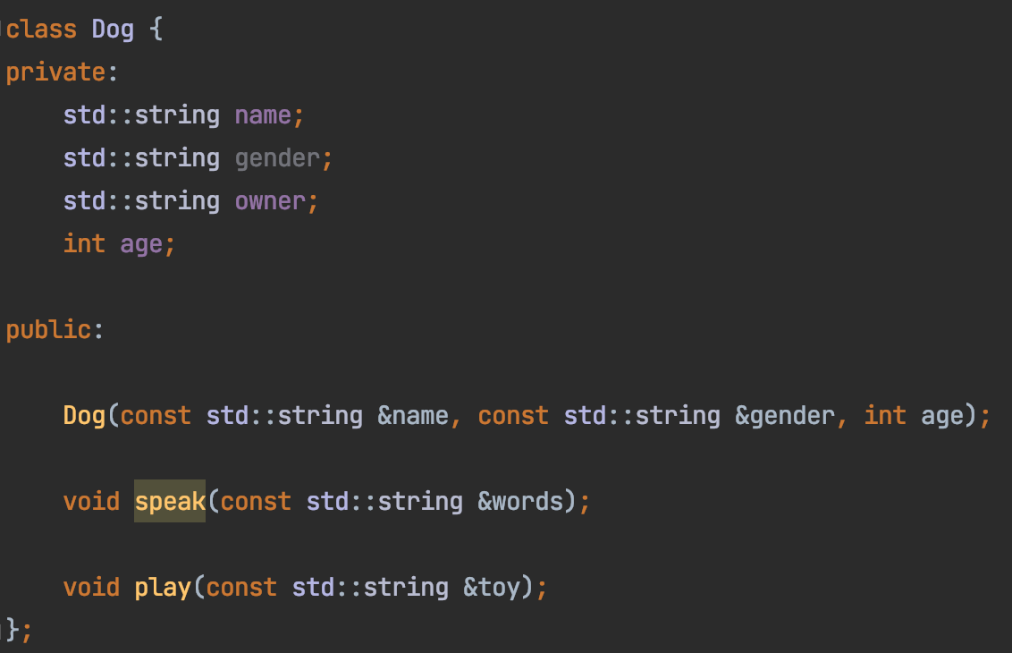
Code here
Implement a class for dogs

Slide 19
Inheritance
Compare the Cat and Dog class
Mostly Duplicated

Slide 20
Inheritance
Animal Class
Name
Gender
Age
Dog Class
Cat Class
Name
Gender
Age
Name
Gender
Age

Slide 21
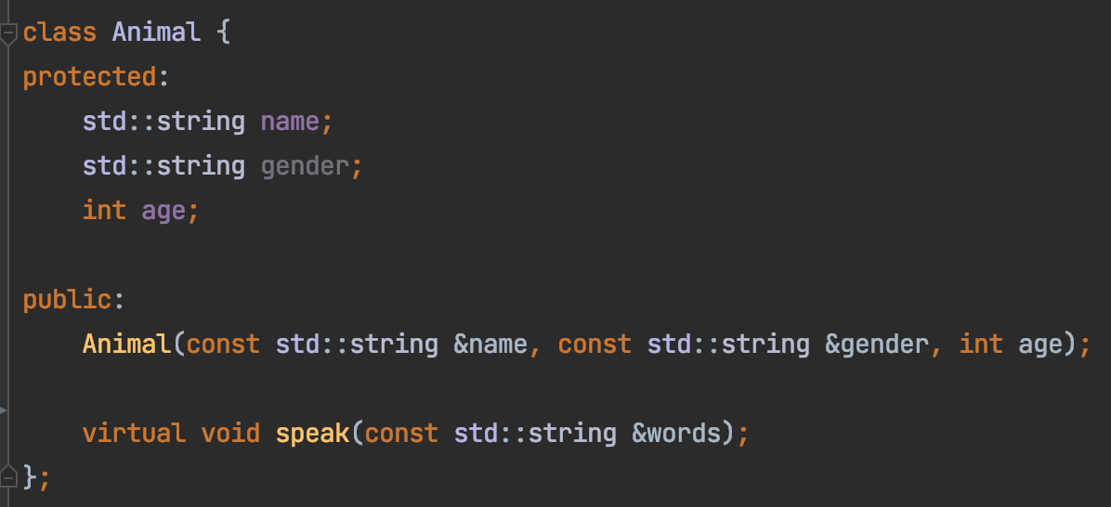
Inheritance
Animal Class
Name
Gender
Age
Base class constructor

Slide 22
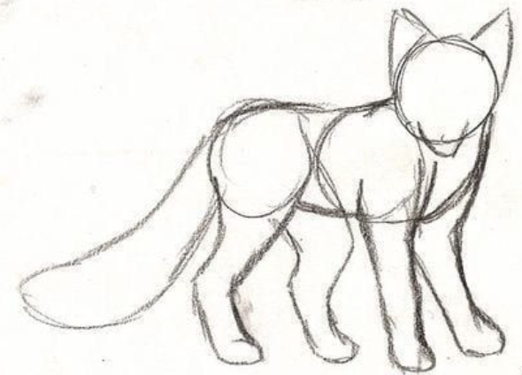
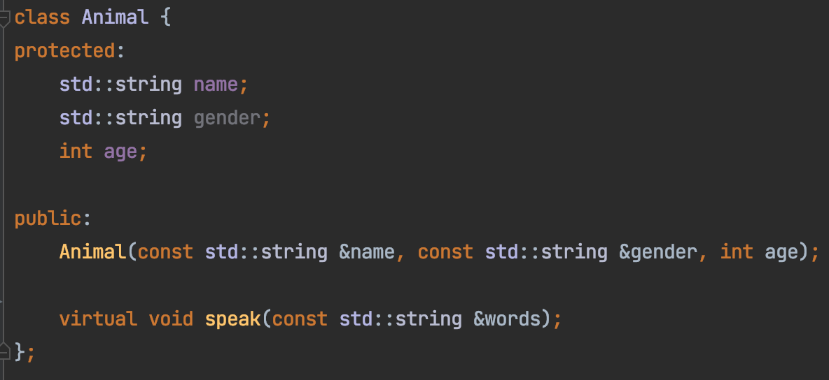
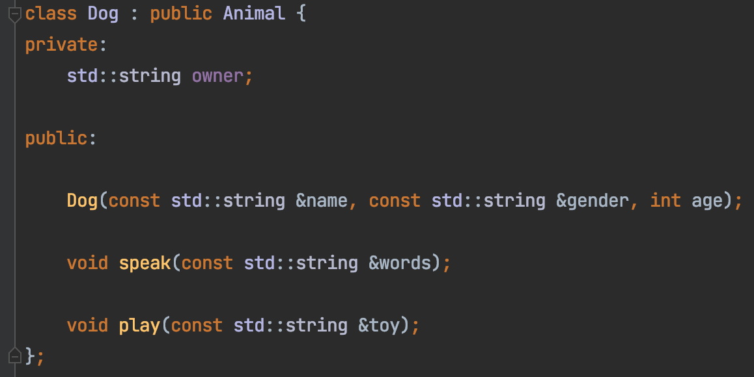
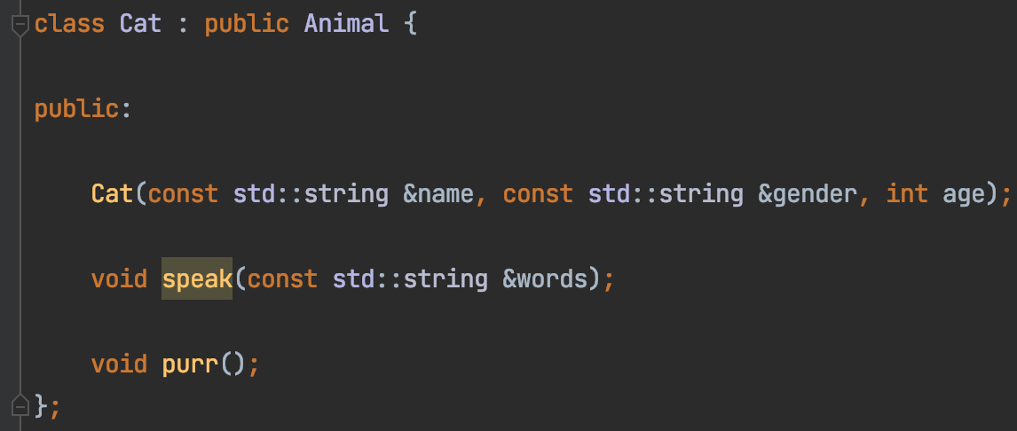
Inheritance

Slide 23
Inheritance
Calling base class constructor

Slide 24
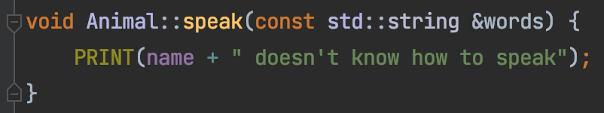
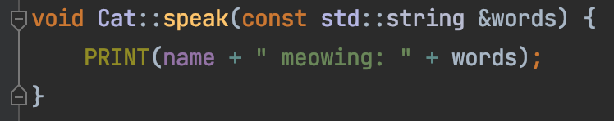
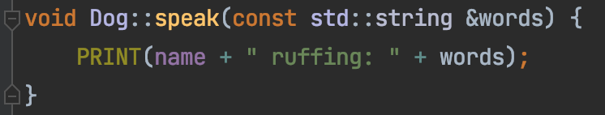
Override vs Overload
Override
Re-implement a function in derived class from base class with the
same name
same signature
Base class function
Derived class function

Slide 25
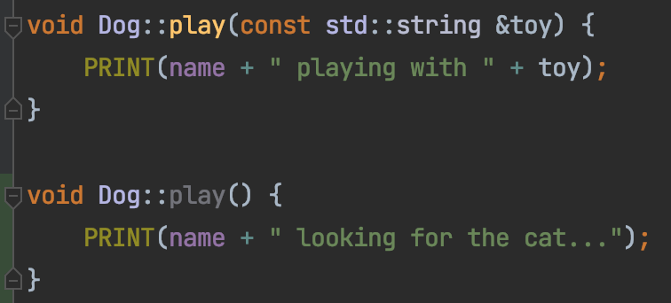
Override vs Overload
Overload
Re-implement a function in the same class
same name
different signatures

Slide 26

Inheritance Summary
Base class & derived class
Use super to access the base
Override vs Overload

Slide 27
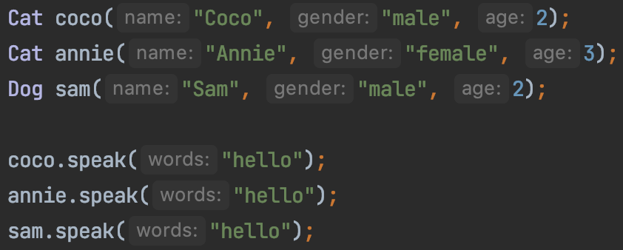
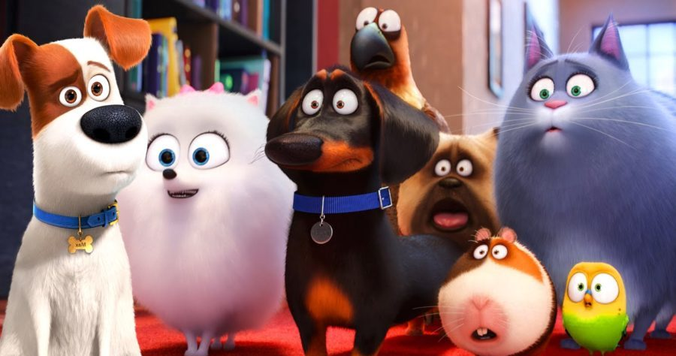
Let all animals play
What if there’s 2000 different animals?

Slide 28
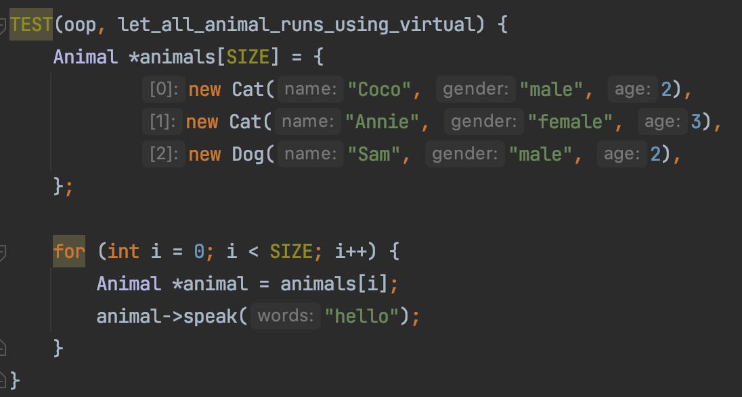
Let all animals play

Slide 29
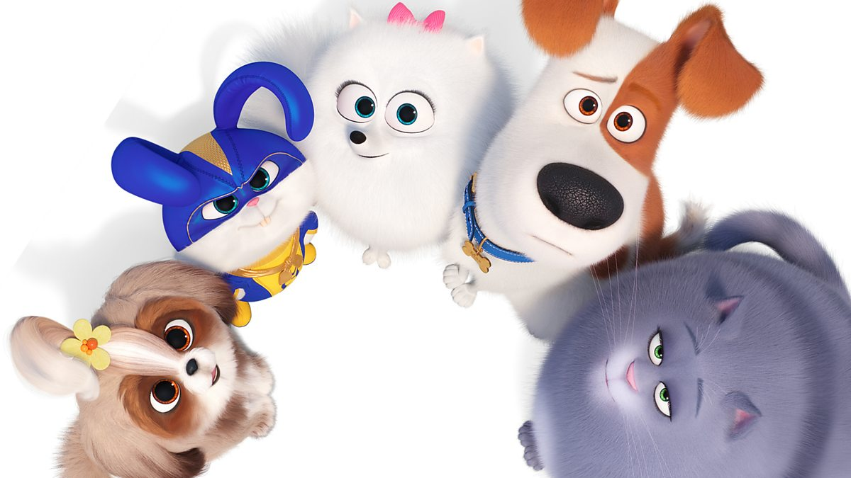
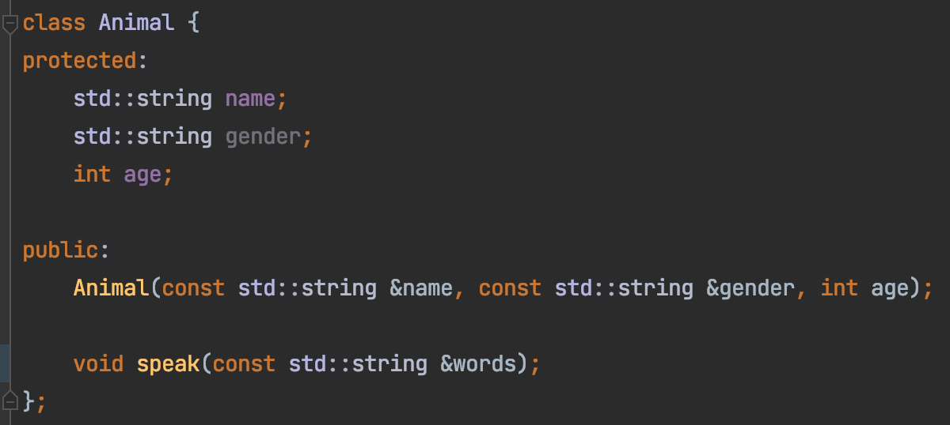
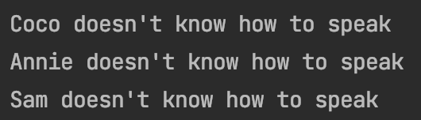
Let all animals play

Slide 30
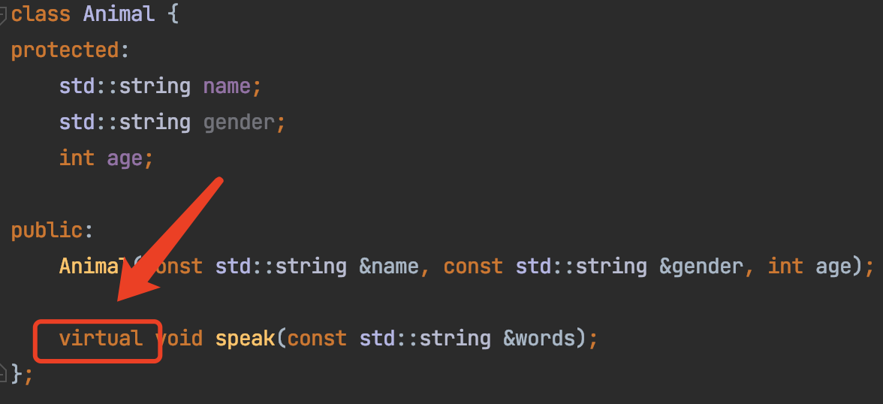
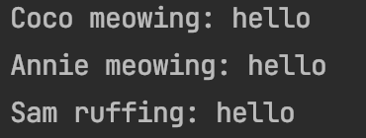
Let all animals play
Code here

Slide 31
Animal::speak() is NOT virtual
Derived Class
Cat cat;
Animal * p_cat = &cat;
Animal::speak()
Animal Class
p_cat -> speak()
Cat::speak()

Slide 32
Animal::speak() is virtual
Derived Class
Cat cat;
Animal * p_cat = &cat;
Animal::speak()
Animal Class
p_cat -> speak()
Cat::speak()

Slide 33
Virtual Function Demo
Code here
Base Class
Derived Class
int *base_class_data
Base Class
int capacity
int capacity
get_capacity()
get_capacity()
~BaseClass()
~BaseClass()
Inheritance
int *derived_class_data
get_capacity()
~DerivedClass()

Slide 34
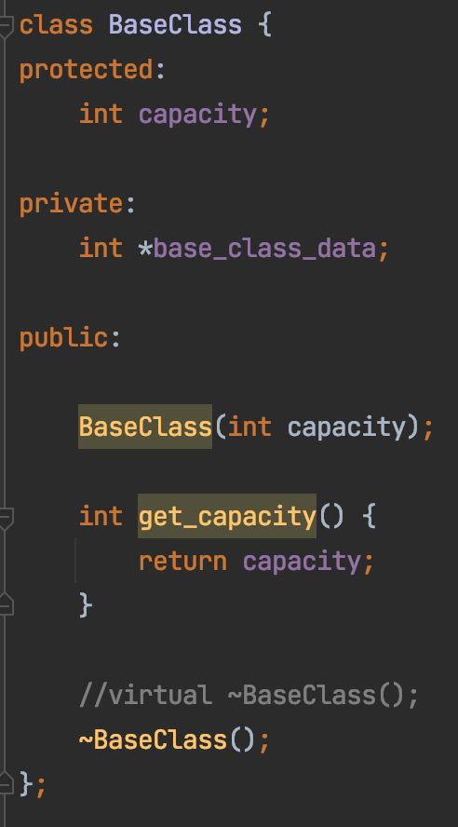
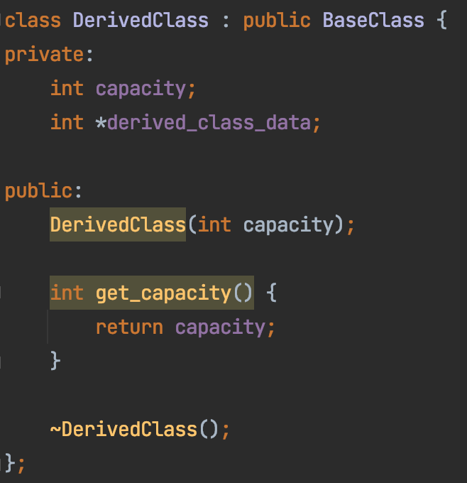
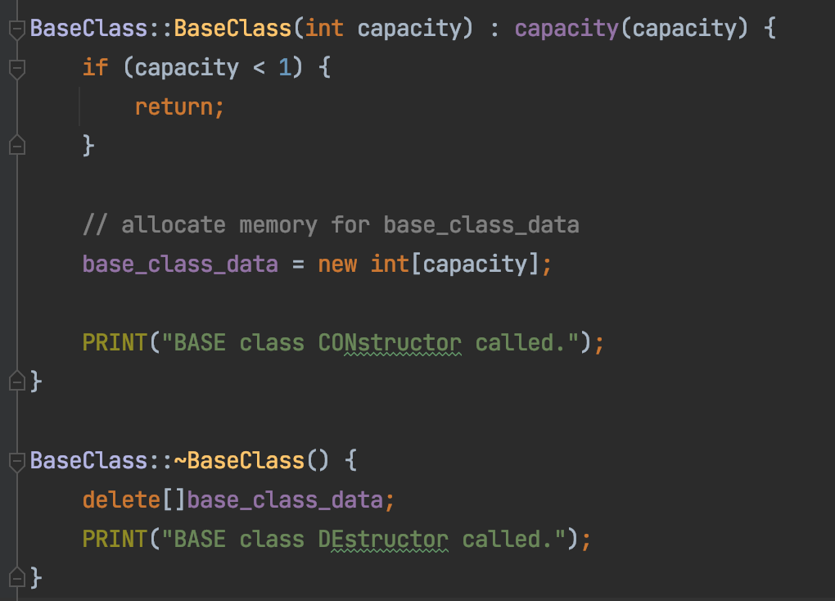
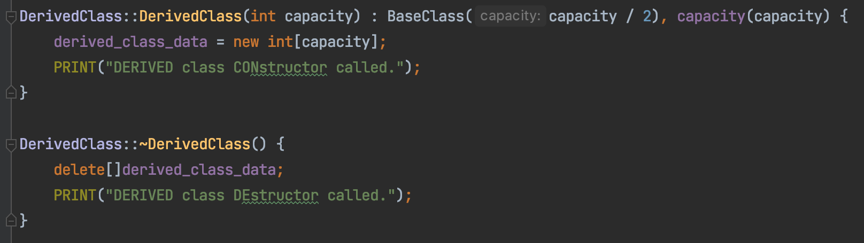
Virtual Function Demo
Base Class
Derived Class

Slide 35
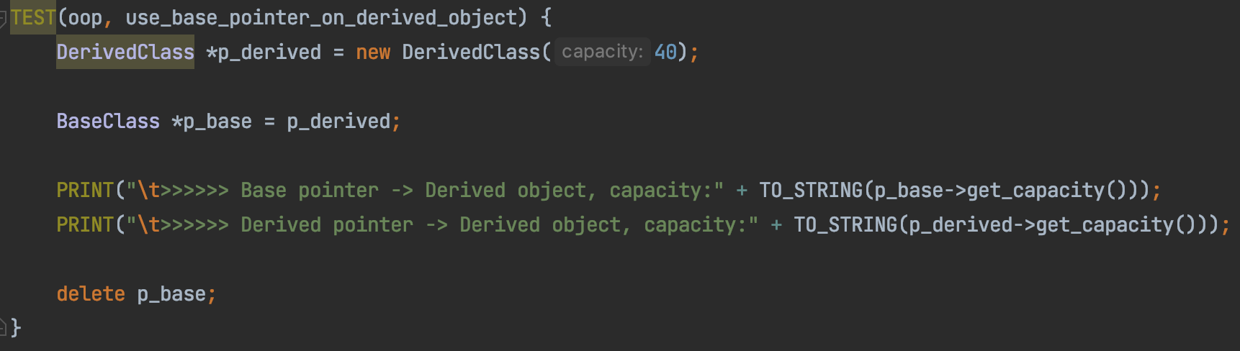
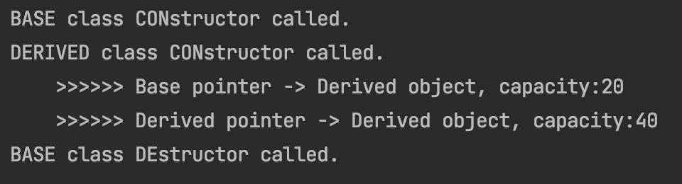
Virtual Function Demo
Derived destructor NOT called → Memory leak!

Slide 36
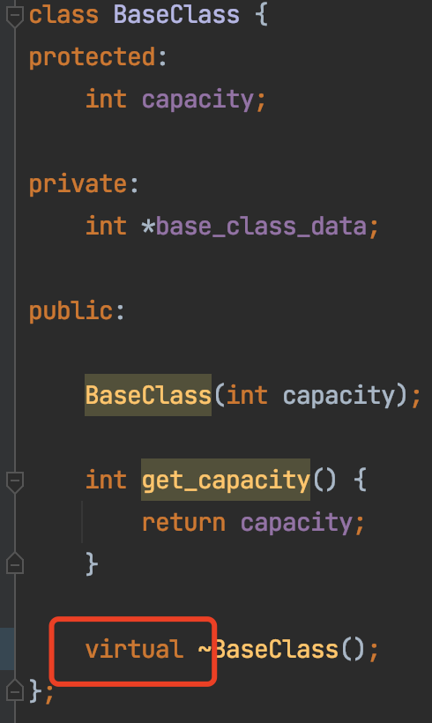
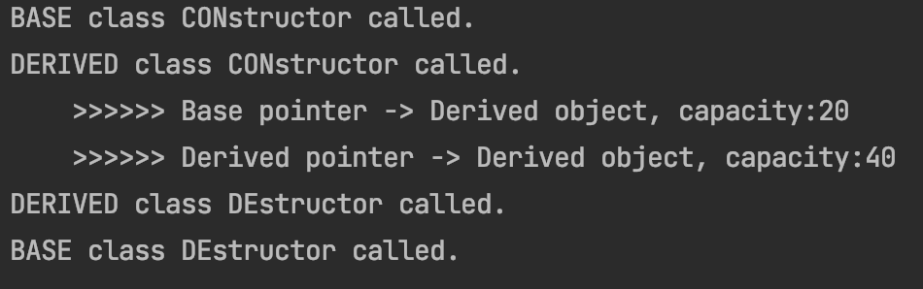


Virtual Function Demo
Derived class destructor called → Memory leak!

Slide 37
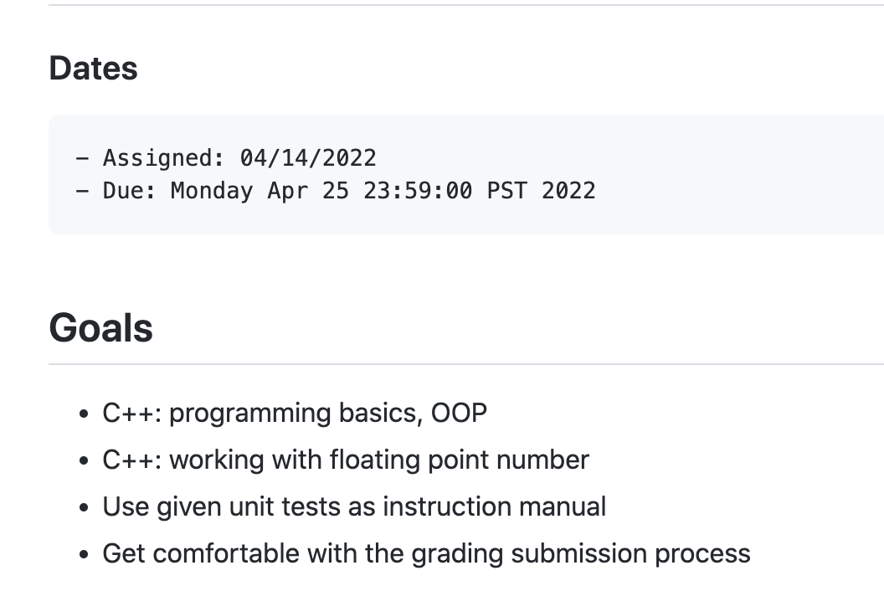
Homework 2 review

Slide 38
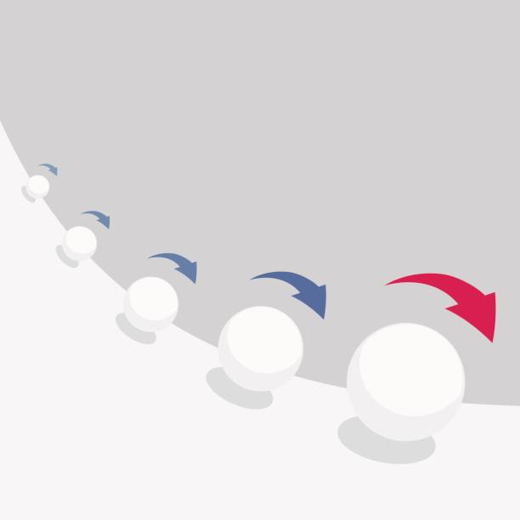
Problem 1: Compound Interest
Definition:
a repeated small step produces over time acceleratingly large result
Financially
Investment
Debt (e.g. credit card)
Study
Lift habit

Slide 39
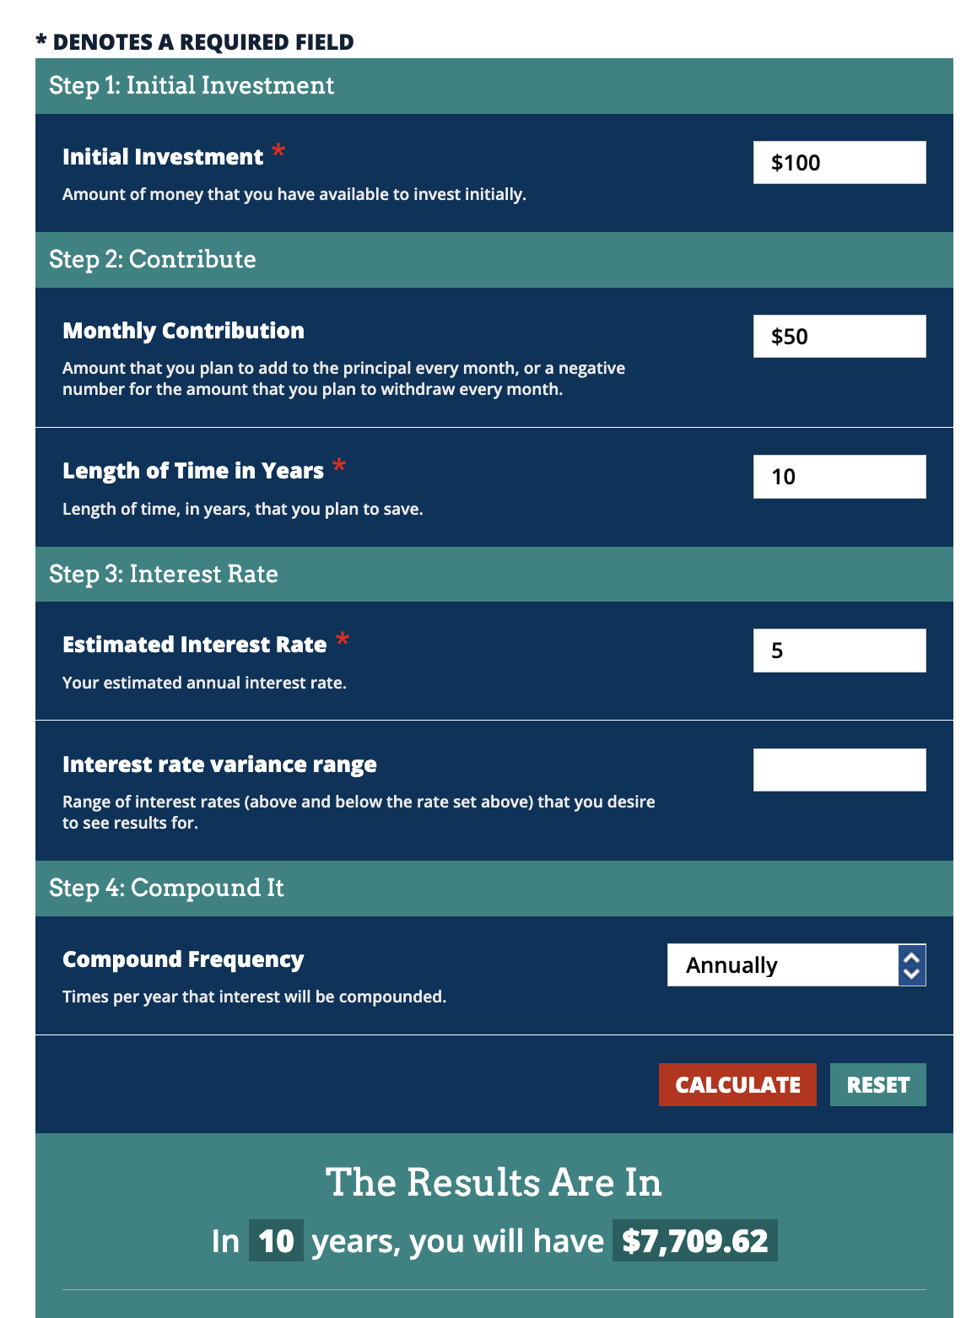
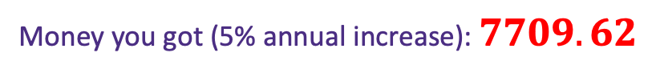

Example (the good way)
Use the web calculator here
Money you put in: $100 + 50×12×10=6100$
Money you got (5% annual increase): $7709.62$

Slide 40
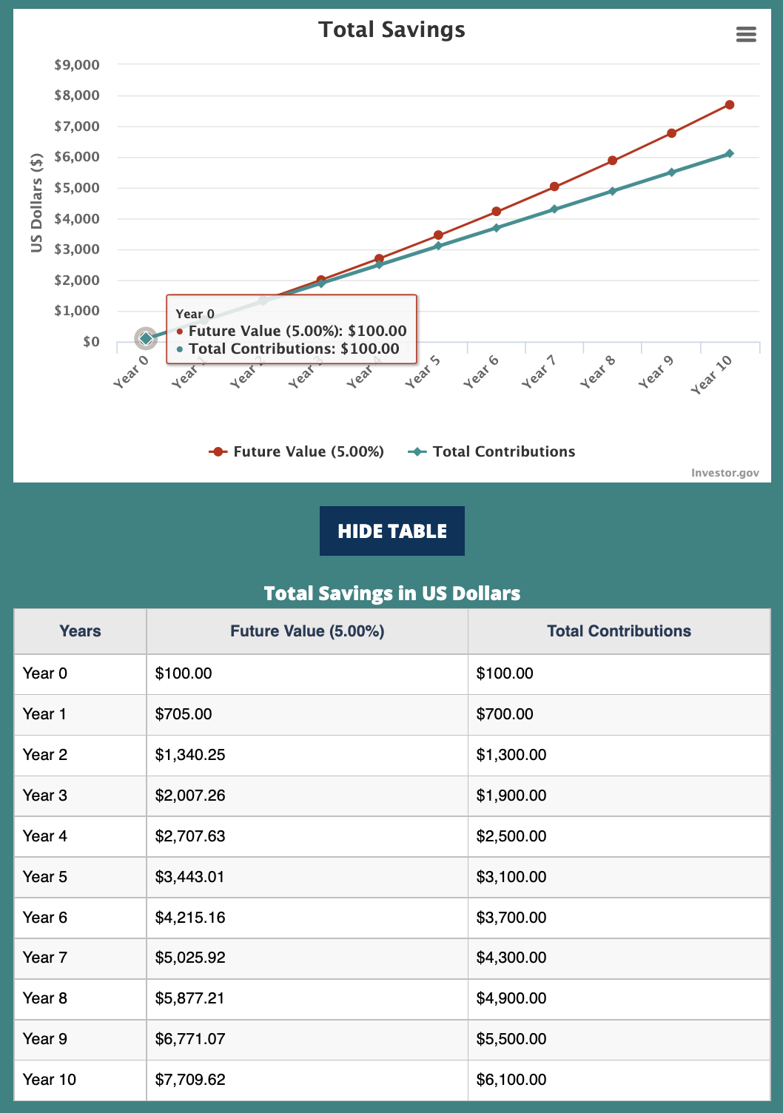
Example

Slide 41
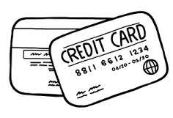
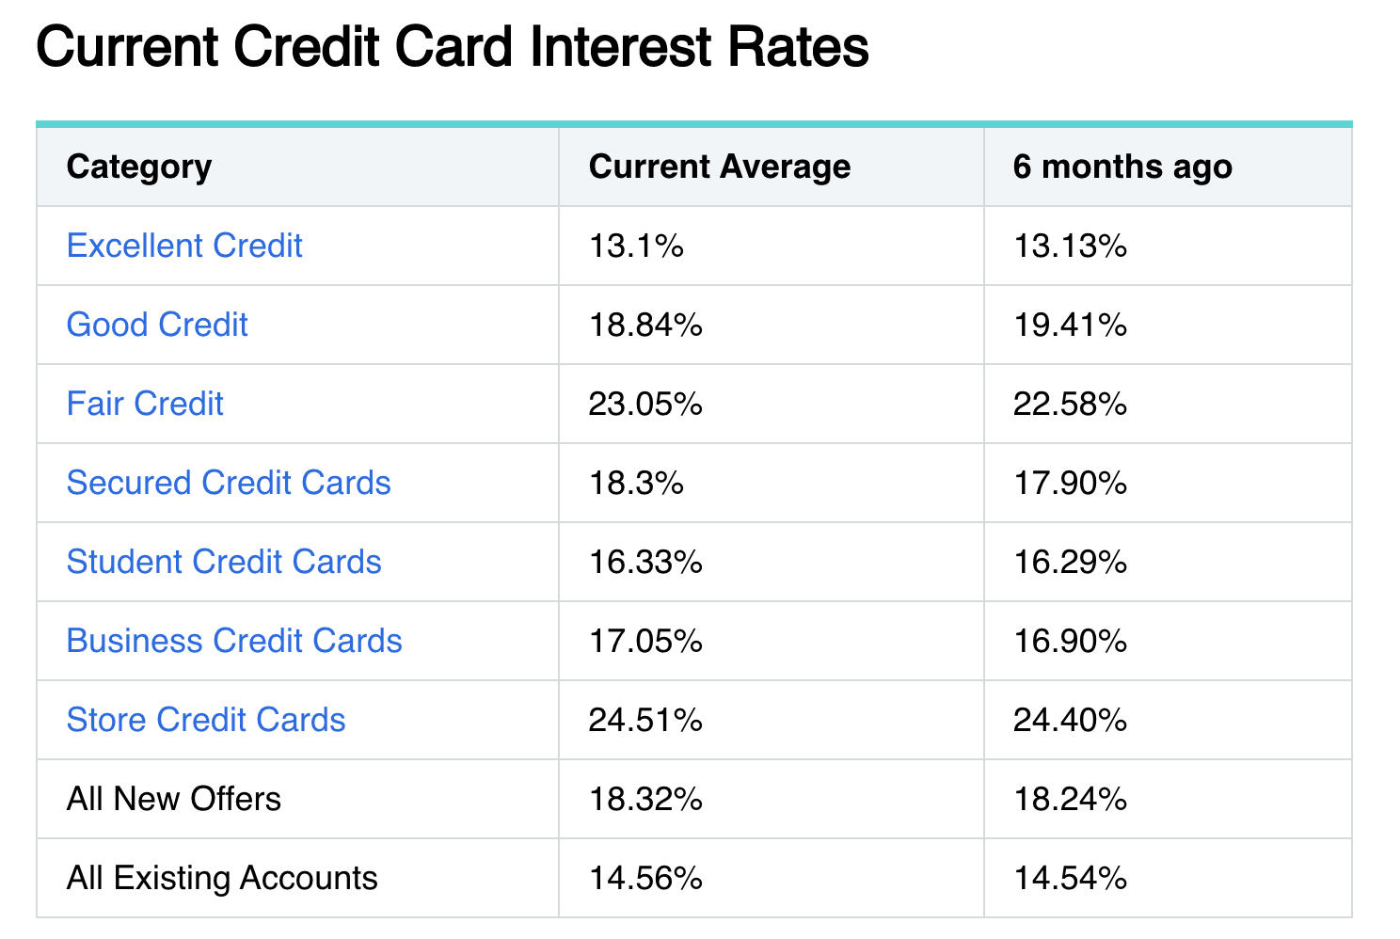
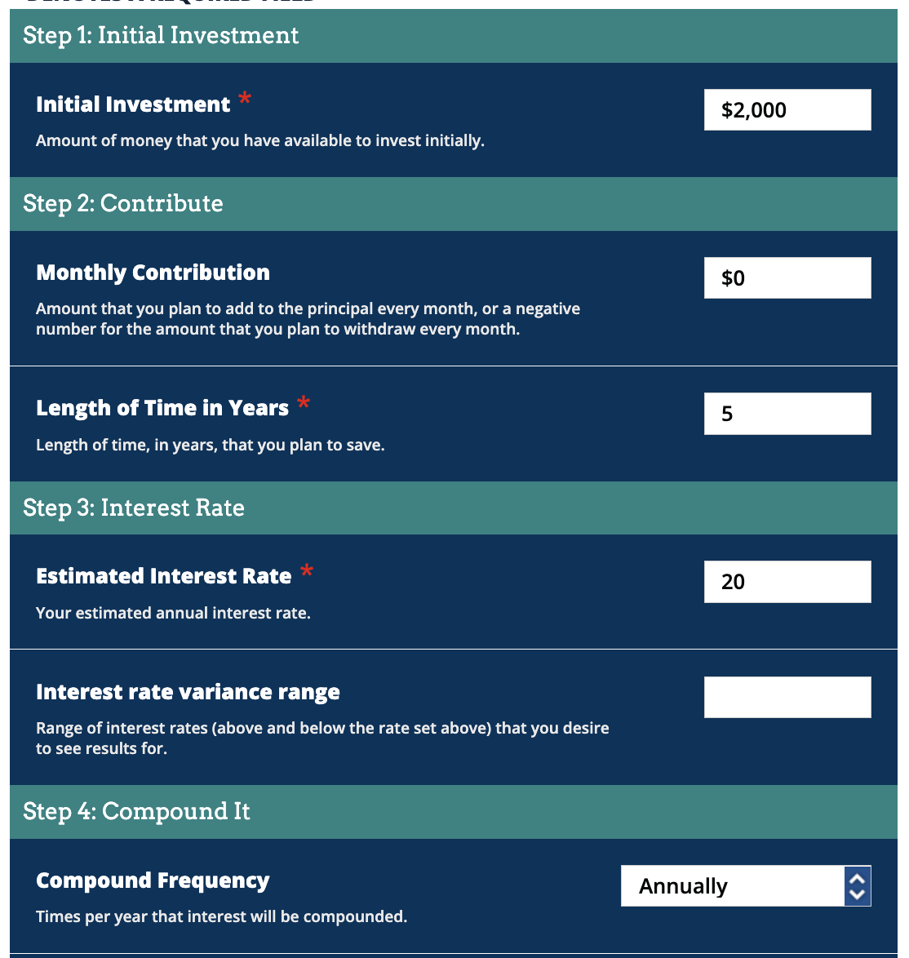
Example (the bad way)
How much do you own the bank after 5 years?
4,976.64
Use the web calculator here

Slide 42
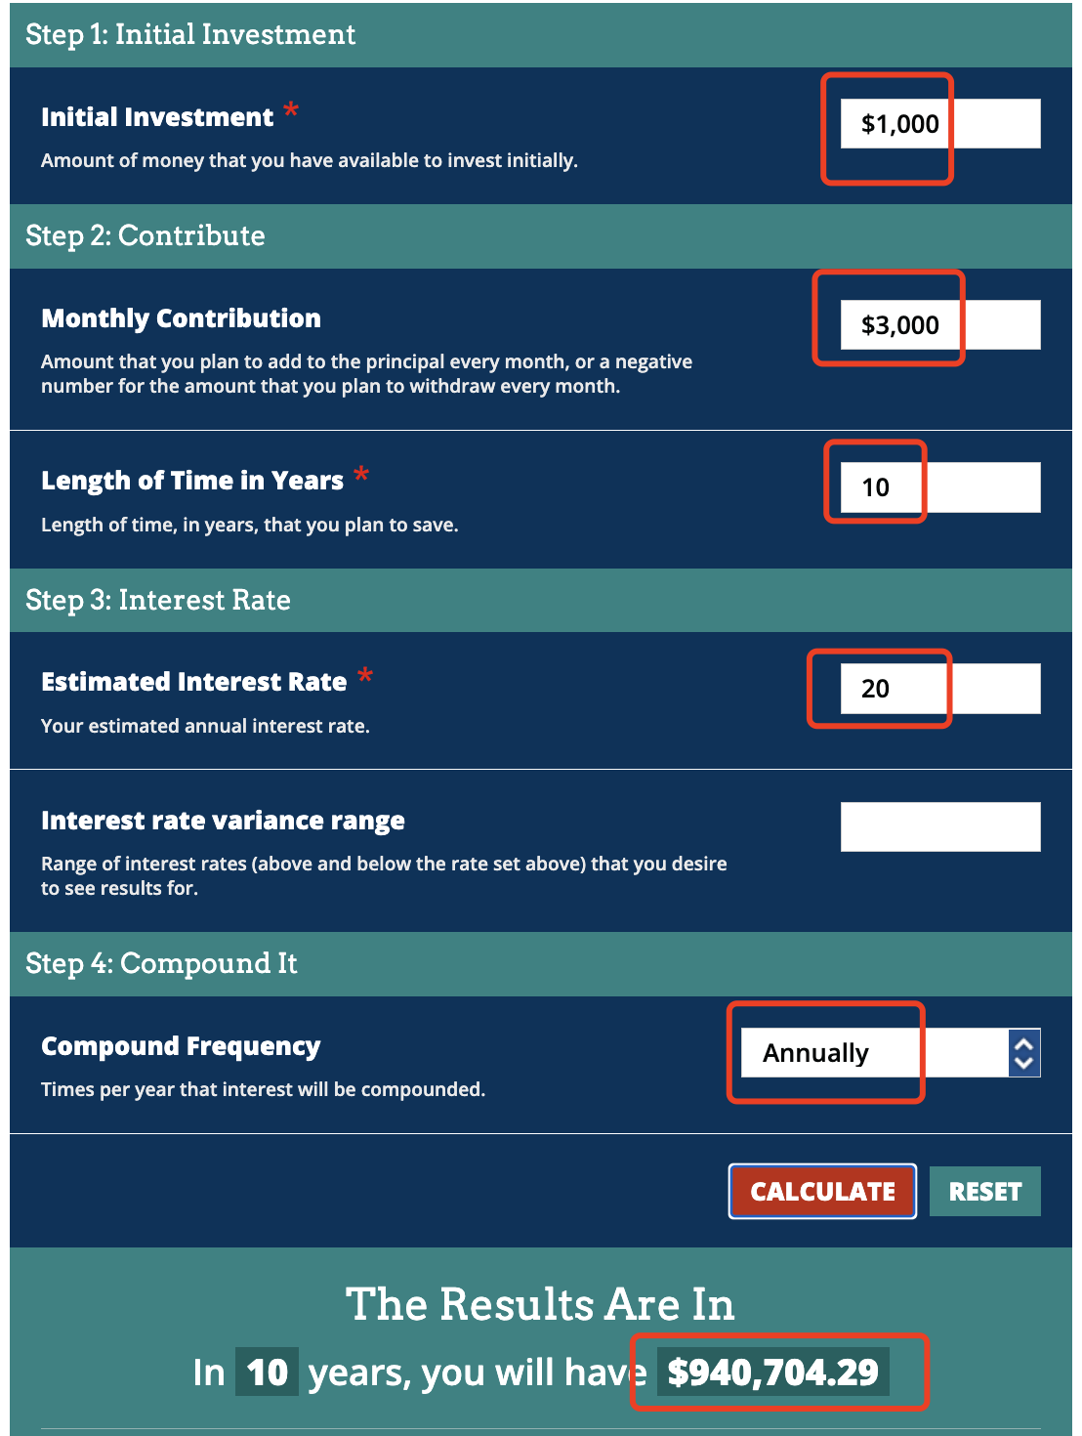
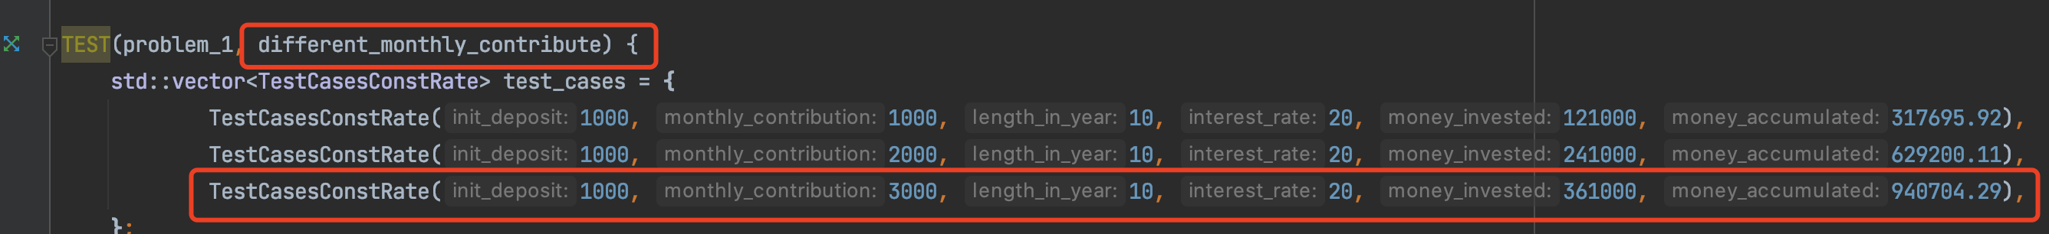
Problem 1
Input
??
Output

Slide 43
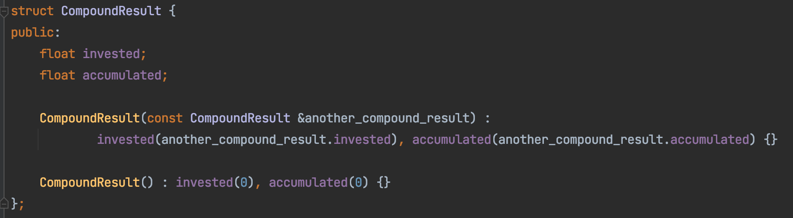
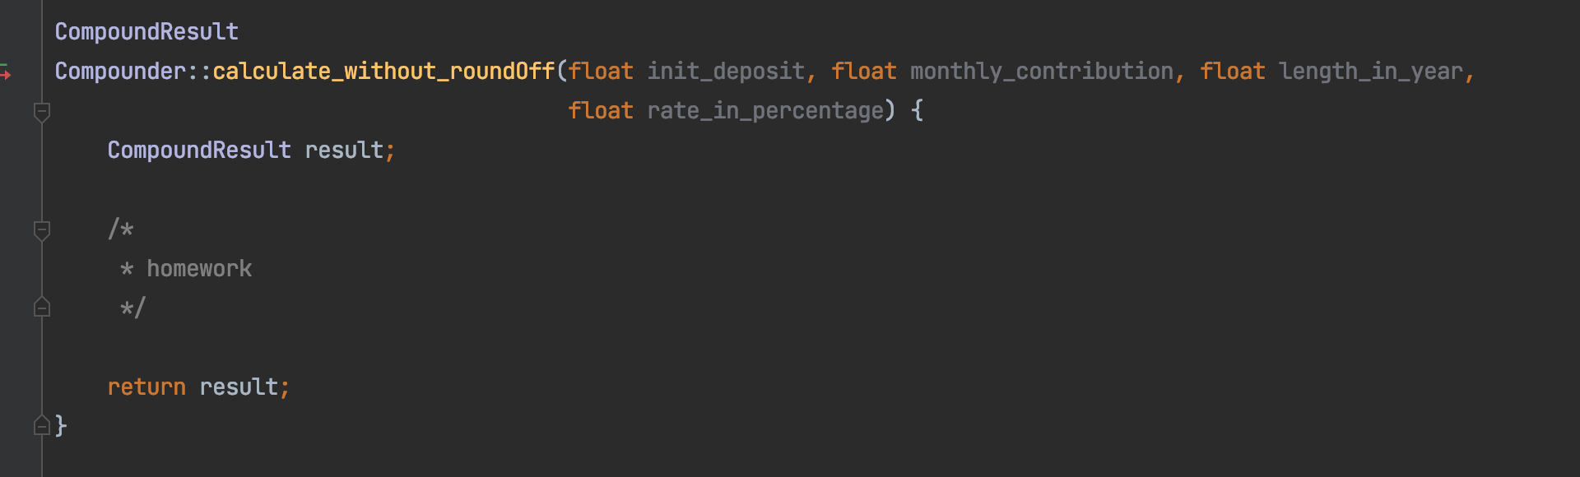
Task
Link
Link

Slide 44



The Formula
Try this example:
Monthly deposit
$$×$$
12
+
Initial Deposit
Annual deposit
$$×$$
annual increase rate
Yearly deposit

Slide 45
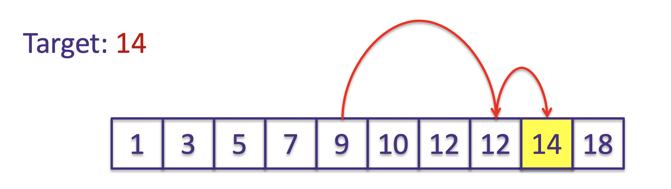
Problem 2
Abstract Data Type
“write our own data type to store data using class”
Why?
Help solve problem
Our Cool Data Type
Save(…)
Read(…)
Find(…)

Slide 46
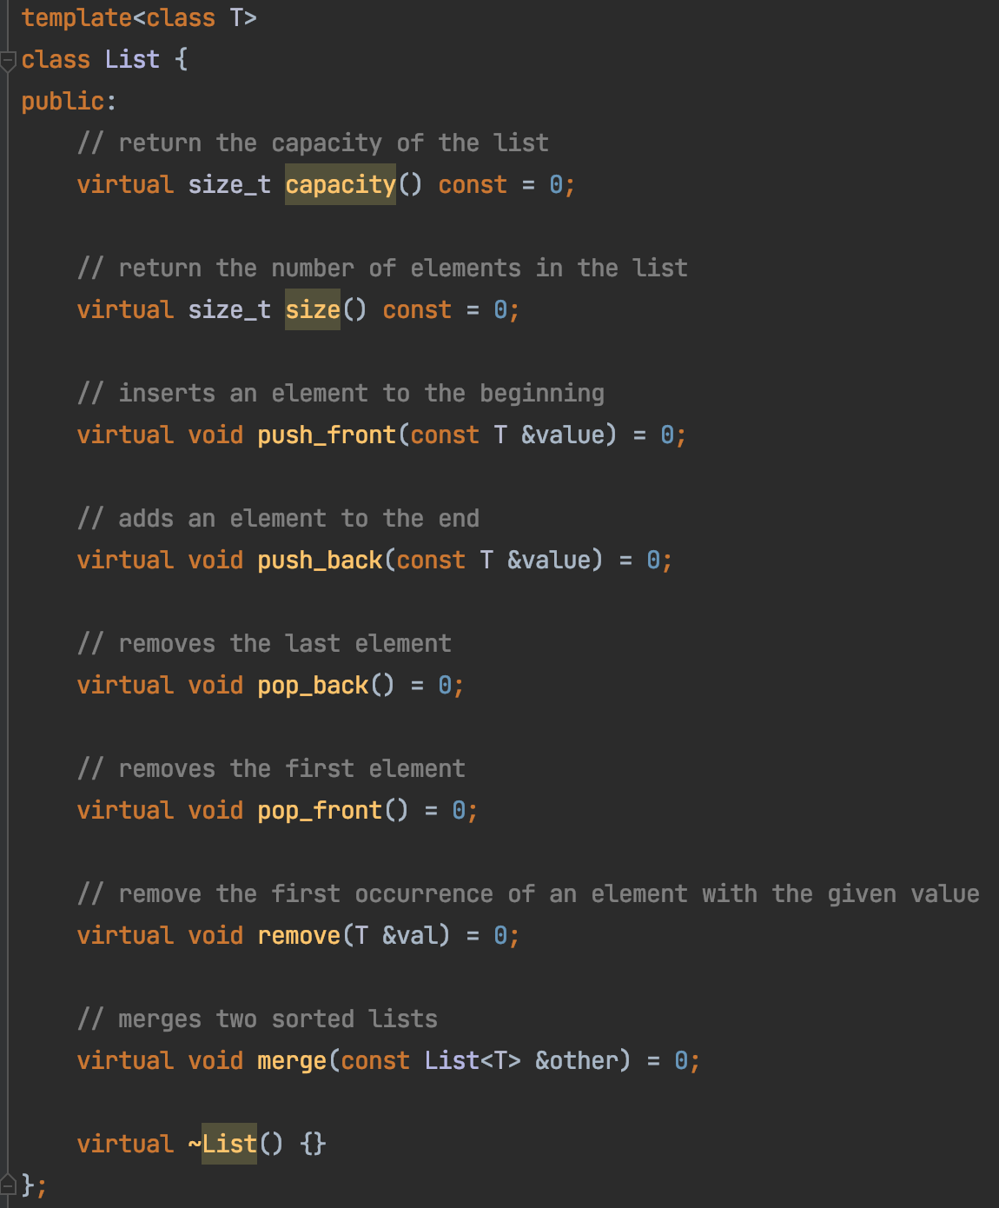
Problem 2
Abstract Data Type
“write our own class to store data”
front
end
List
(index 0)
(index 2)
(index 3)
(index 1)
Save(…)
Read(…)
Find(…)

Slide 47



Problem 2
Read the “manual”

